Slide 1
Lesson 6 – Hands-On
Kai Bartlette

Slide 2
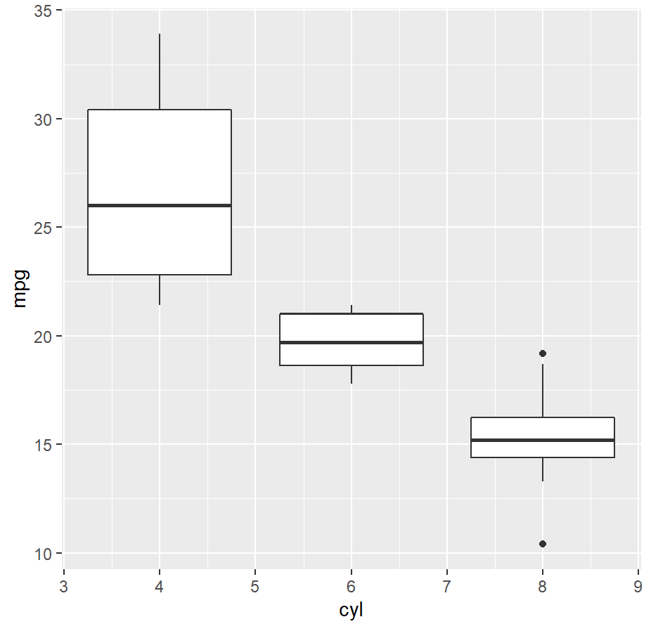
Do these box plots make sense?
Yes, they do make sense. They are grouped by 4, 6, and 8 cylinder engines and include the distributions of fuel efficiency in MPG.

Slide 3
To create the box plot in RStudio:
ggplot(mtcars, aes(x = cyl, y = mpg)) + geom_boxplot(aes(group=cyl))

Slide 4
Vehicle Count by Cylinder
11 cars have 4 cylinders, 7 cars have 6 cylinders, and 14 cars have 8 cylinders.
To compute the vehicle count in RStudio: mtcars %>% group_by(cyl) %>% summarize(count = n())

